Slide 1

Game For Kids With Diabetes
Team: Jawad Nasser, Shayna Mehta, spruce bondera, Mitchell vitez, and Angel Perez

Slide 2
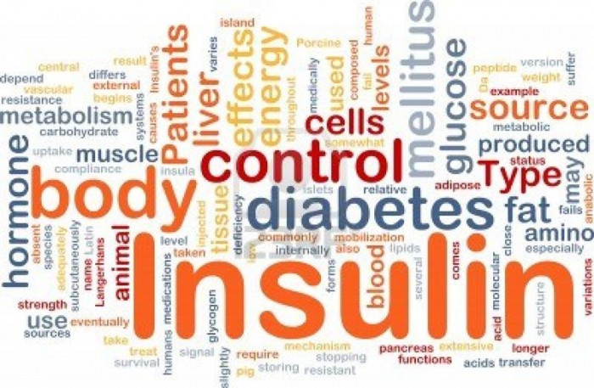
Ultimate goals
Help children realize that diabetes doesn’t define them
Aid with the daily aspects of the disease
Educate
Make the process fun

Slide 3
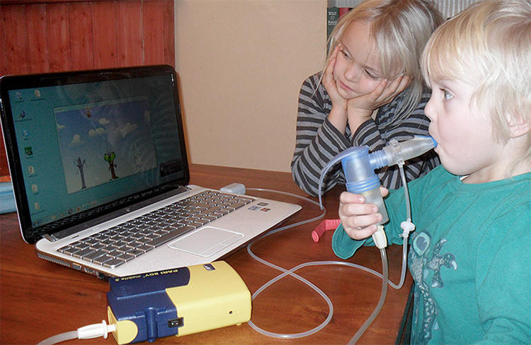
A Related Example: Cystic Fibrosis
Source: http://www.fastcoexist.com/3043606/using-gamification-to-get-sicks-kids-excited-about-their-treatment?partner=rss#2
Notes:
Before going into the details of our solution, here’s an example for further understanding our solution

Slide 4
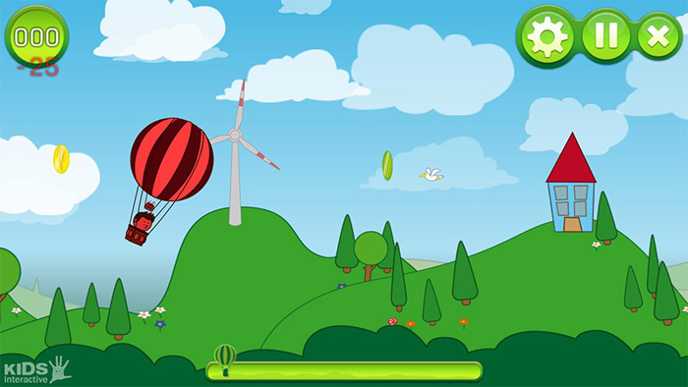
Cystic Fibrosis: Their Issue and Solution
Issue: Young children and proper nebulizer treatment
Solution: A three-part game that reacts to the nebulizer

Slide 5
Our Issue At Hand
Children have trouble counting carbs and eating certain amount
“No one will know if I eat all this ice cream at school…”
“I think this only 10 more carbs, so it’s alright if I eat it…”
Literal pain to check blood glucose levels
“It hurts, why do I have to do this? It hurts!”
“I don’t want to hurt right now, I’ll do it later”
Children are finicky- repetitive simple game they don’t like won’t cut it

Slide 6
Our Solution
Immersive mobile game
Will ask children at appropriate times for diabetes-related tasks
Will track various data and report to parents

Slide 7
Planned Reach Features
Teach about diabetes and importance of the various tasks
Community with other kids
Include children without diabetes
Allow parents to interact with kids in-game

Slide 8
Current Example
Choose a pet that wins coins by doing tasks
Tasks include aspects of disease monitoring such as carb counting
Coins can buy things for pet such as toys and accessories
If child misses a task, their pet responds accordingly (gets sad, hungry, etc)
Parent can set carbs per meal, reminders, and more

Slide 9

This semester
Create a Android and iOS app
Features
Basics of the game – avatar, tasks, coins
Carb counter feature
Parent’s inputting the data for the tasks and notification if a task is missed

